Slide 1
Capstone Design Week12 Presentation
2016124099 박관영
2016124103 박상준
2016124124 사재현
2016124145 양해찬

Slide 2
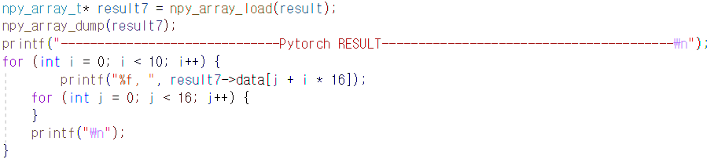
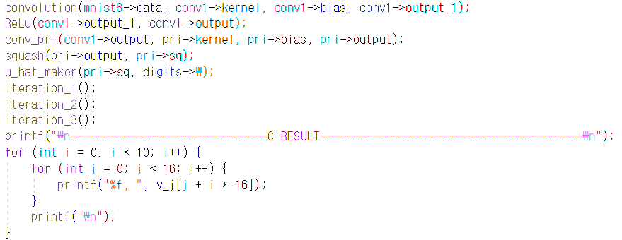
Main 함수

Slide 3
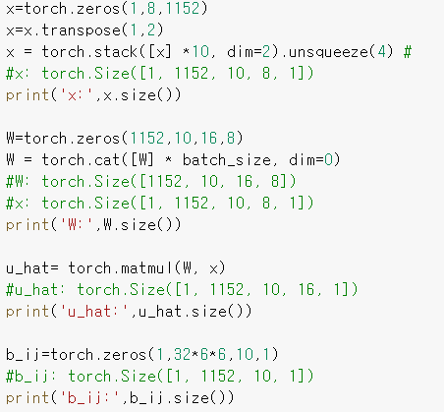
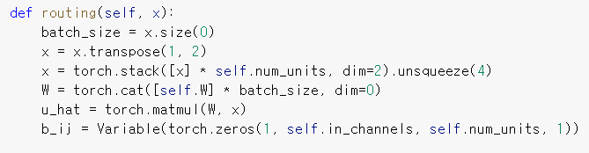
Routing
u_hat (before iteration)
Transepose, stack, matmul 작업이 필요함
Torch.cat은 batchsize를 위한 연산이므로 제외.

Slide 4
1.5812312312323123123
0.158123123 * 10¹
12323.5812312312323123123
0001.58123
9999.99999

Slide 5
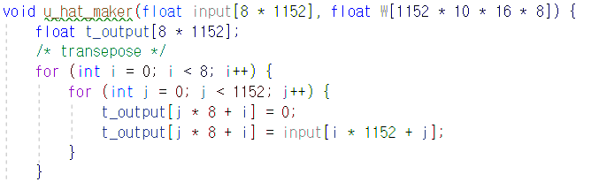
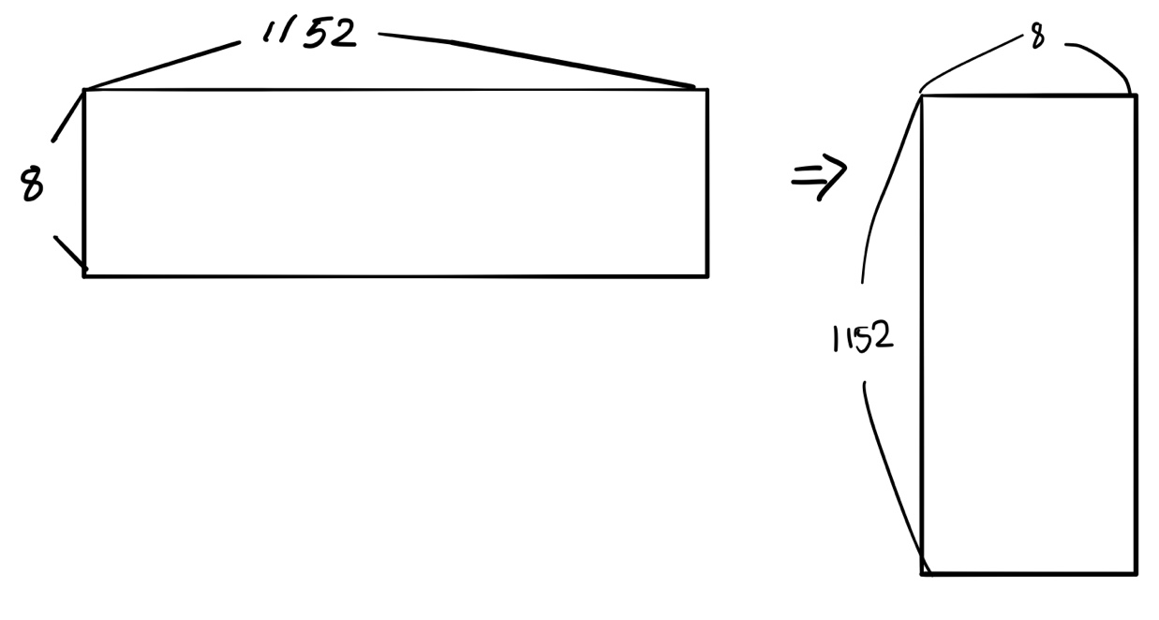
Routing
x=x.transpose(1, 2)

Slide 6
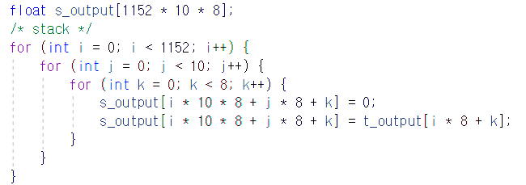
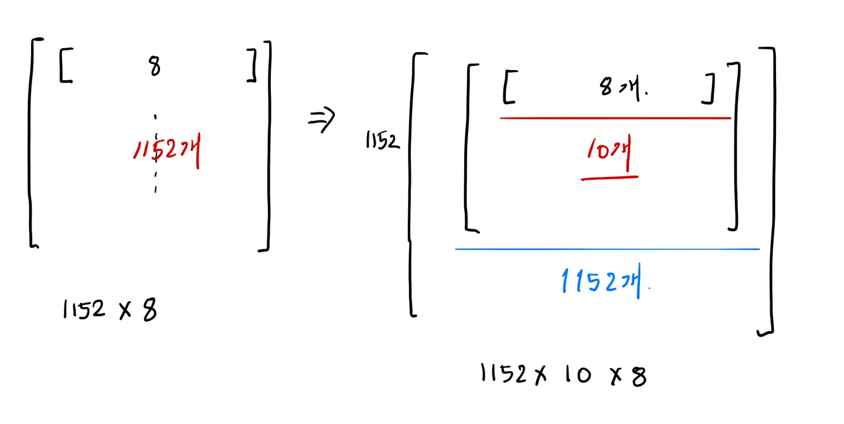
Routing
X=torch.stack([x]*10,dim=2)

Slide 7
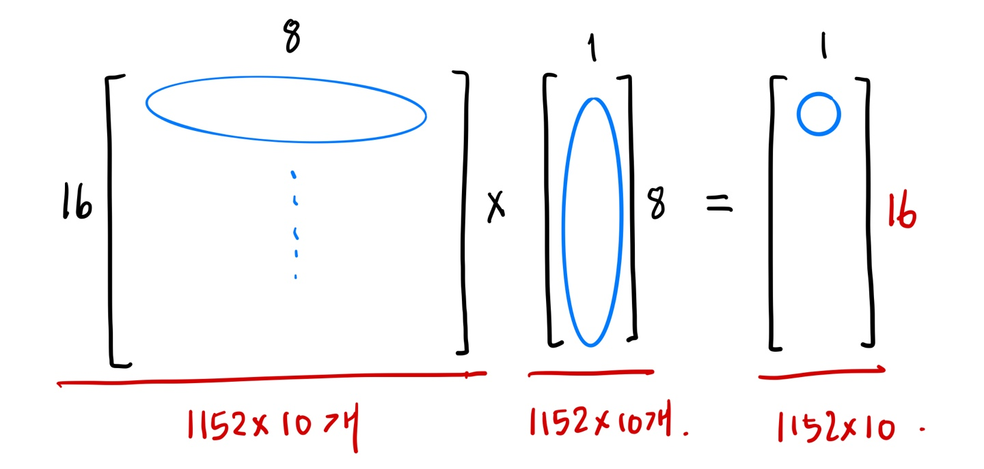
Routing
u_hat=torch.matmul(W,x)
W = 1152 * 10 * 16 * 8
X = 1152 * 10 * 8 * 1

Slide 8
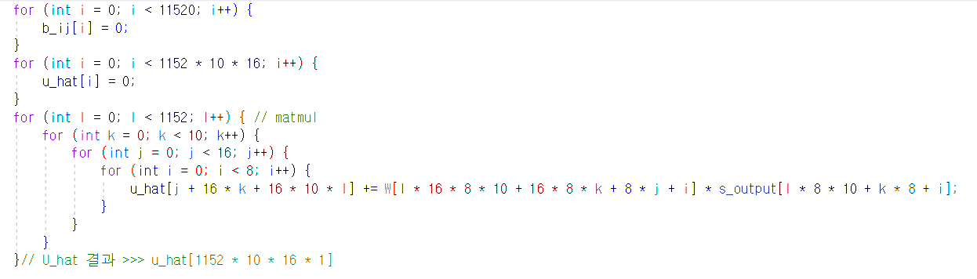
Routing
u_hat=torch.matmul(W,x)

Slide 9
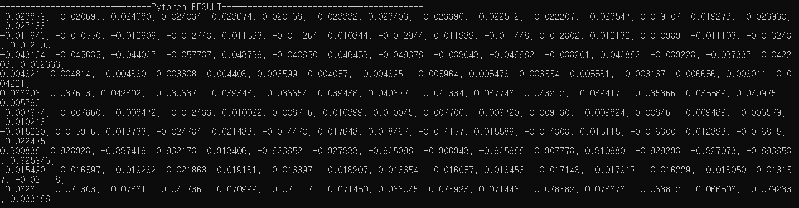
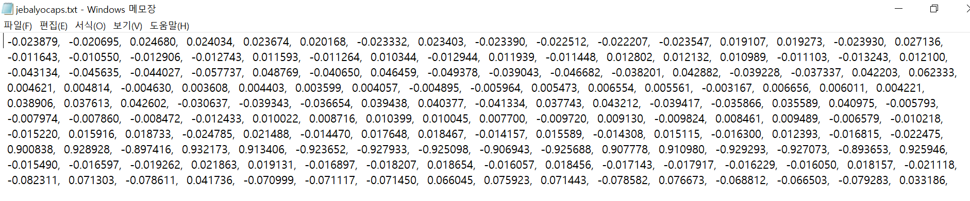
C inference result

Slide 10
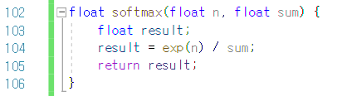
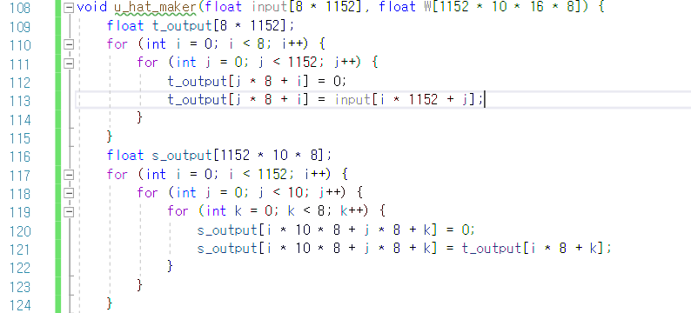

U_hat_maker
>>> softmax
>>> transpose
(8, 1152) ➔ (1152, 8)
>>> stack
(1152, 8) ➔ (1152, 10, 8)

Slide 11
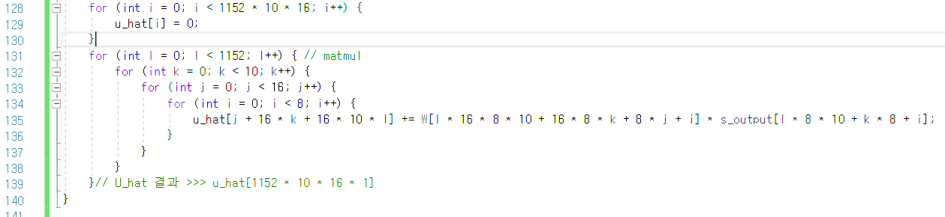
U_hat_maker
>>> matmul 연산
(1152, 10, 16, 8) * (1152, 10, 8, 1) ➔ (1152, 10, 16, 1)

Slide 12
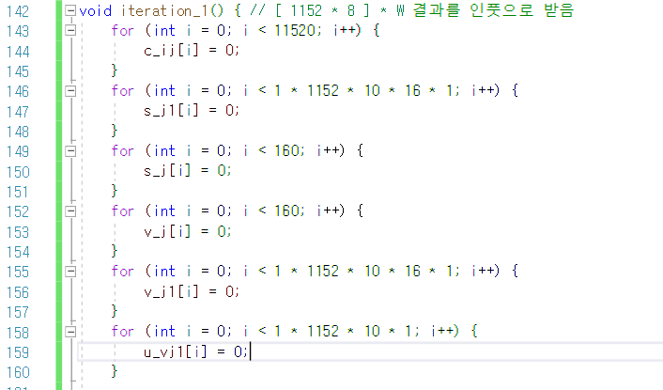
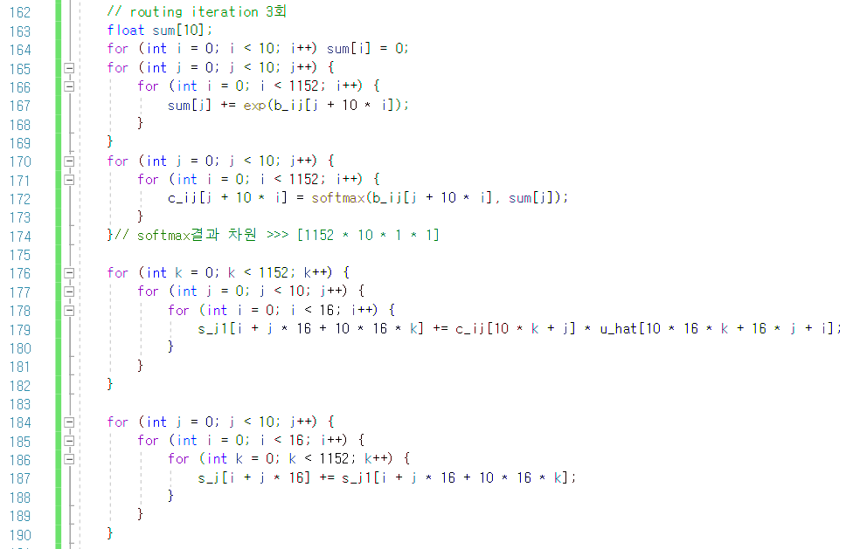
Routing iteration x3
>>> 각 iteration에서 쓸 matrix 초기화
>>> softmax
(1152, 10) ➔ (1152, 10)

Slide 13
Routing iteration x3
>>> routing sum
(1, 1152, 10, 16, 1) * (1, 1152, 10, 1, 1) ➔ (1, 1152, 10, 16, 1)
(1, 1152, 10, 16, 1) ➔ (1, 1, 10, 16, 1)
두 번의 for loop으로 구현

Slide 14
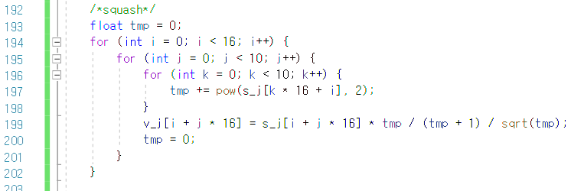
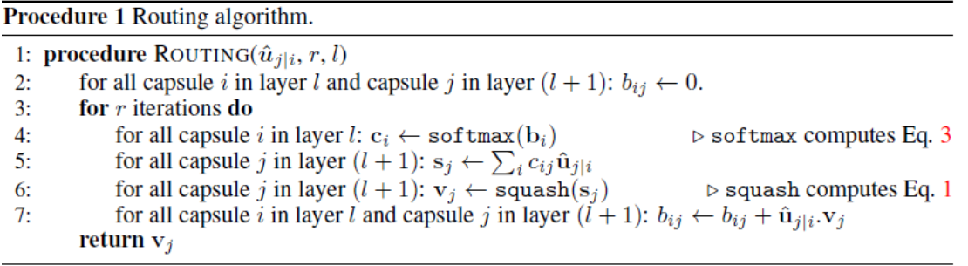
Routing iteration x3
>>> squash

Slide 15
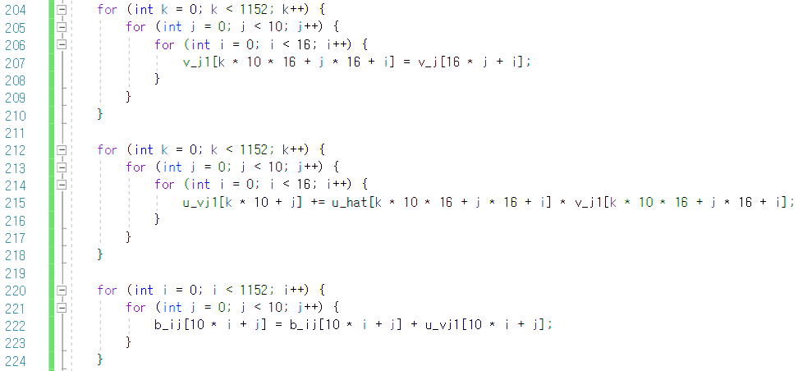

Routing iteration update
>>> (1, 1, 10, 16, 1) ➔ (1, 1152, 10, 16, 1)
>>> (1, 1152, 10, 16, 1) * (1, 1152, 10, 16, 1) ➔ (1, 1152, 10, 1)
>>> (1, 1152, 10, 1) = (1, 1152, 10, 1) + (1, 1152, 10, 1)
마지막 iteration에서는 update를 실행하지 않는다.

